Slide 1
CHAPTER 1 : LEARN TO LEARN
CHEATING

Slide 2

OBJECTIVES FOR THIS SESSION
What is cheating ?
What are the consequences of cheating

Slide 3



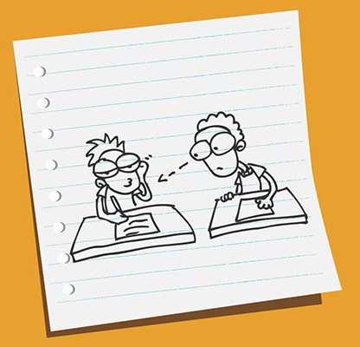

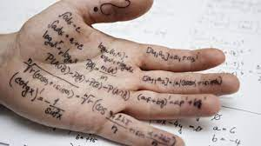
ENGAGE
Cheating competition !
10 MIN
Think about all the possible ways of cheating
The group who has the more ideas wins !
1
MAKE TEAMS !!
2
DISCUSS IN TEAM !!
(5 min)
3
PRESENT TO THE CLASS !!
(5 min)
TO COMPLETE THIS ACTIVITY :
3 students per team

Slide 4
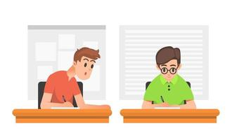



What is the impact of cheating ?
DISCUSS
30 MIN
In Academic life
In Professional life
On Personal emotions
In Social life
TO COMPLETE THIS ACTIVITY :
1
EXPERT TEAM DISCUSSION
(05 min)
2
HOME TEAM DISCUSSION
(05 min)
3
CLASS PRESENTATION
(10 min)
Notes:
This activity is named Jigsaw :
please see scheme in file C1-S3 if you need clarification…
MATERIAL NEEDED: post-it
TODO :
Activity explanation : 5 min
Step 1 : Put students in 4 teams :
Team 1 : Personal emotions
Team 2 : Professional life
Team 3 : Social life
Team 4 : Academic life
Each team discuss the impact of cheating for the aspect of life of their team. => Team 1 will discuss the impact of cheating on personal emotions, team 2 will discuss the impact of cheating on professional life etc.
They need to give explanations and/or examples. => Cheating will cause me stress because I’ll be scared to be caught.
10 min
Step 2 : Change the teams :
1 team = 4 students = 1 student team “personal emotions” + 1 student “professional life” + 1 student “social life” + 1 student “academic life”
Each student share the reflection they had in their previous team. => The student of team “personal emotions” will explain to the rest of his/her team the impact of cheating on personal emotions. Etc.
15 min
Step 3 : Class presentation :
The students share their ideas to the class.
10 min

Slide 5

What is the impact of cheating ?
05 MIN
Academic life
Professional life
Personal emotions
Social life
Prevents progress
Breaks PNC laws
Leads to class failure
Hard to find a job
Low self-esteem
Brings embarrassment
Presents a false character
Low self-esteem
Lake of independence
Causes of stress
Is disrespectful to the other students and your teachers
Makes it harder to make friends
Brings bad reputation
Notes:
Cheating can lead to Class Failure : When you are caught cheating during an examination, there are penalties. (PNC rules)
Prevent progress : cheating arms the progress of your learning process, which makes it not worth trying.
We go to school to learn. The courses we learn are vital in our development in academic, social, and economic development. This means that students who are involved in cheating will not make any progress because they are not learning the skills that will build them in the future unless they start afresh.
Hard to find a Job : When your transcript shows that you cheated in college, securing a job becomes almost an impossibility. Nobody wants to employ an incompetent person. Through knowledge from the broken window theory, the employers believe that anyone involved in cheating once can do it again and again. They will not want at all to risk their companies.
Creation of a false character : Some students involved in cheating in the college exams may complete their course successfully without being caught. This means that all the documents and certificates that the college gives the student are not a representation of the student’s capabilities (hard skills and soft skills). This is what creates a false character.
Brings lake of independence : Students who cheat do not believe that they can make it on their own. They do not believe in their reasoning capabilities. This character grows and the student can carry it thereafter. Even at workplaces, such students become inefficient.
Brings low self-esteem: Students who cheat know they break rules, they are disrespectful to teachers and students. They are not proud of themselves. This can apply to the psychological and the professional life.
Causes stress : Consequences that may befall you if caught, the worry of being caught, and the reactions of your family and friends if caught must cross your mind. After cheating you will always be insecure if you suspect that somebody knows what you did. These thoughts can cause psychological torture and can easily cause stress.
Brings Embarrassment : People will disregard you and lose trust in you. They will view you as a lazy, unintelligent, incompetent, disrespectful, selfish, mean, and careless person. When you are expelled from school, you will feel embarrassed as you carry your belongings home. Being barred from joining a university because you cheated causes disappointments and embarrassment too. This is perhaps the most discouraging of all the effects of cheating in school.
Is disrespectful to the other students and your teachers : Cheating in college examinations is a shortcut to success. You will have put no effort to deserve any accolades you get. This is a high form of disrespect for teachers who have taught you. They may have sacrificed a lot to make sure you learn and expect you to pass by doing exams fairly which you did not. Cheating also is a form of disrespect to students who have worked hard to achieve what they have got but you surpass them by cheating.

Slide 6
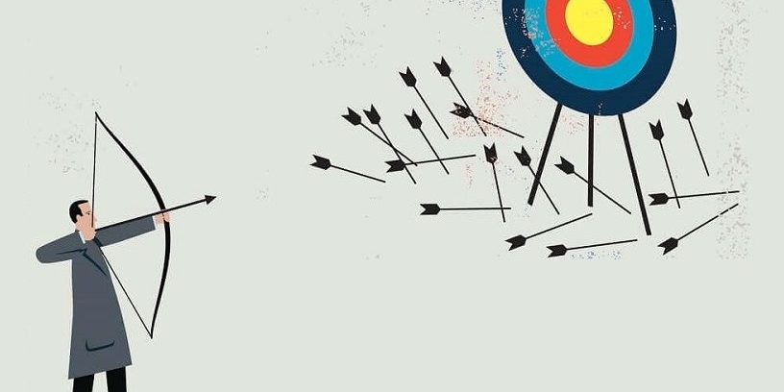
DISCUSS
10 MIN
Why making mistakes make you learn better ?
Notes:
Free participation

